Slide 1
Chapter 1 Introduction to Software Engineering

Slide 2
Lesson Objectives
Differentiate between Generic and Bespoke software product
Describe what is software engineering and its importance
Discuss the key challenges of software engineering and the professional responsibilities for software engineers

Slide 3

What is Software?
Software is the detailed instructions that control the operation of a computer system.
Without software, computer hardware could not perform the tasks we associate with computers.

Slide 4
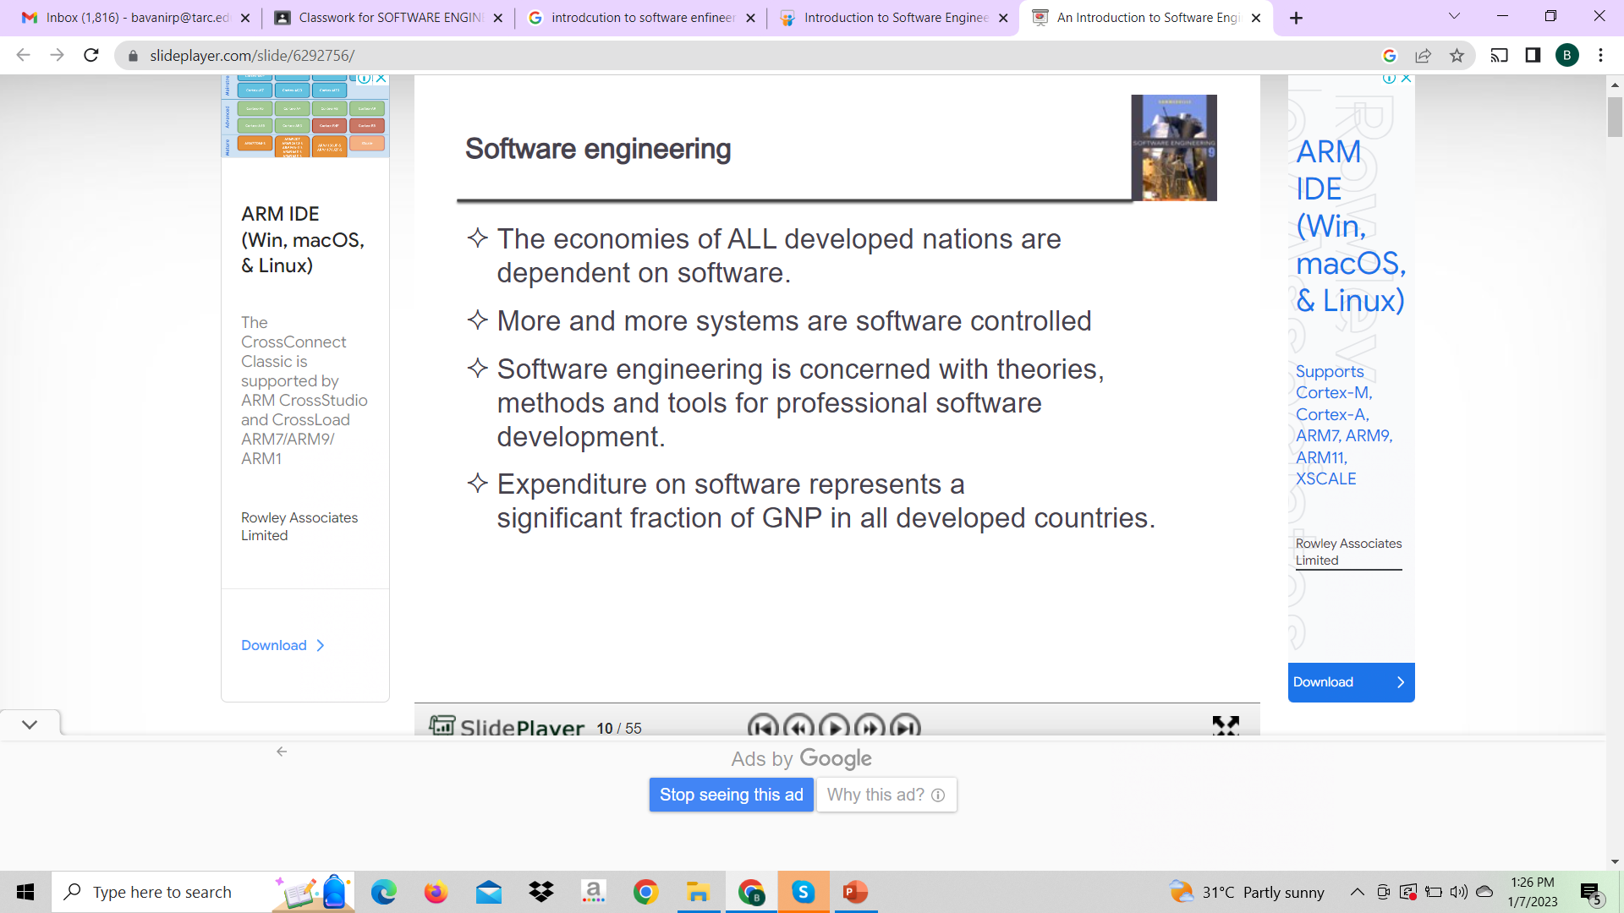

Slide 5
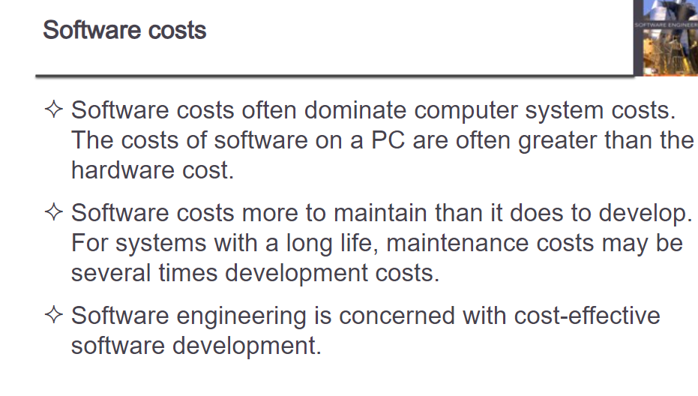

Slide 6

Functions of Software
Manage resources
Intermediary
Provide tool

Slide 7
Functions of Software
The functions of software are to: -
Manage the computer resources of the organization
Provide tools for human beings to take advantage of these resources
Act as an intermediary between organizations and stored information.

Slide 8

Characteristics of Software
Developed or Engineered
Doesn’t “wear out”
Continues to be custom built

Slide 9
Characteristics of Software
Software is developed or engineered, it is not manufactured in the classical sense
Software doesn’t “wear out”
Most software continues to be custom built
Notes:
Software is developed or engineered; it is not manufactured in the classical sense. Although some similarities exist between software development and hardware manufacture, the two activities are fundamentally different. In both activities, high quality is achieved through good design, but the manufacturing phase for hardware can introduce quality problems that are nonexistent (or easily corrected) for software. Both activities are dependent on people, but the relationship between people applied and work accomplished is entirely different. Both activities require the construction of a "product" but the approaches are different.
As we know software is that part of computer science, that does not have physical existence. But we can feel the existence. Basically a software is of two type. An operating system or a Application program. Both are a/group of codes design to carry out a specific task. When it is matter of coding then we can say it as developed. But when it adds properties like maintenance, extensibility and quality and is within time and budget and also satisfies all the requirements given by user. Here comes software engineering. Software engineering is the branch of software that deals software development that meets all the requirements of the user in a time bound.
Saying that something is manufactured means that it is created, 'from the ground up', from nothing. And that certain chemical/physical processes are used to create it. Software has NO physical form. It is computer code, instructions for an operating system (something else without physical form). A computer program is kind of like a story, something else without physical form.
People who write computer programs use nothing of a physical process to create the software. They simply use words/letters to create the code. The finished code is called 'software'. Sometimes the software is an operating system, a program, a widget, or simply 'code'.

Slide 10

Types of Software
There are two major types of software: -
Application software
System software

Slide 11
Types of Software
Operating System
Translators
Compilers
Loaders
Utility Programs
Examples of System Software

Slide 12
Types of Software Product
Software engineers are concerned with developing software products, i.e. software, which can be sold to a customer.
Two types of software product:
Generic products
Bespoke (or customized) products

Slide 13


Slide 14
Attributes of Good Software
Availability
Reliable
Attributes of Good SW
Functional
Economical
Efficient

Slide 15
Attributes of Good Software
Secure
Manageable
Attributes of Good SW
Flexible
Buildable
General

Slide 16
Attributes of Good Software
Maintainable
Safety
Attributes of Good SW
Useable
Reusable

Slide 17
Attributes of Good Software
Availability - the probability that a system will work as required when required during the period of a mission
Functional - system will perform the functions that it is required to
Efficient - the system performs those functions efficiently in terms of time and resources
Economical - running costs of system will not be unnecessarily high
Reliable - not prone to hardware or software failure, will deliver the functionality when the users want it

Slide 18
Attributes of Good Software
Secure - protected against errors, attacks and loss of valuable data
Flexible - capable of being adapted to new uses, to run in different countries or to be moved to a different platform
General - general-purpose and portable (mainly applies to utility programs)
Buildable - Design is not too complex for the developers to be able to implement it

Slide 19
Attributes of Good Software
Manageable - easy to estimate work involved and to check of progress
Maintainable - design makes it possible for the maintenance programmer to understand the designer’s intention
Usable - provides users with a satisfying experience (not a source of dissatisfaction)
Reusable - elements of the system can be reused in other systems
Safety - the control of recognized hazards to achieve an acceptable level of risk

Slide 20
What is Software Engineering?
Software engineering is an engineering discipline, which is concerned with all aspects of software production from the early stages of system specification through to maintaining the system after it has gone into use.
Software Engineers apply theories, tools & methods that are appropriate to discover solutions & work within company’s constraints

Slide 21
What is Software Engineering?
Engineering discipline:
Software Engineers apply theories, tools & methods that are appropriate to discover solutions & work within company’s constraints.
All aspects of software production:
Technical processes, software project management, development of tools, methods to support software production.

Slide 22
What is Software Engineering?
Software engineering is a layered technology consisting of the following four important layers
Technical how-to’s
Tools
Methods
Key process areas (KPAs)
Process
A Quality Focus

Slide 23
What is Software Engineering?
Quality Focus
Any engineering approach must rest on an organizational commitment to quality.
Total quality management and similar philosophies foster a continuous process improvement culture, and this culture ultimately leads to development of increasingly more mature approaches to software engineering.
Process
Process defines a framework for a set of key process areas (KPAs) that must be established for effective delivery of software engineering technology.

Slide 24
What is Software Engineering?
Methods
Methods are organized ways of producing software. They include suggestions for the process to be followed, the notations to be used, rules governing the system descriptions, which are produced and design guidelines.
Tools
Tools provide automated and semi-automated support for the process and the methods.

Slide 25
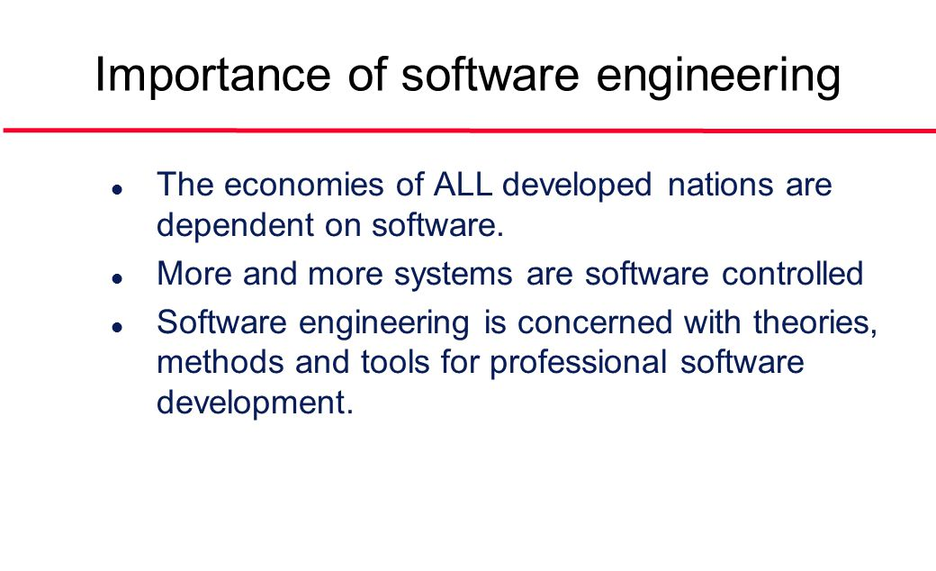
https://www.youtube.com/watch?v=R3NzTt0BTWE

Slide 26

Importance of Software Engineering
Unreliable Product
Behind Schedule
User Needs
Over Budget
Poorly Perform
Difficult to maintain
SOFTWARE PROJECT

Slide 27
Importance of Software Engineering
Hence, software engineering is an engineering discipline whose goal is cost-effective development of software system
SOFTWARE PROJECT

Slide 28

Key Challenges of Software Engineering
Legacy Challenge
Delivery Challenge
Heterogeneity Challenge

Slide 29
Key Challenges of Software Engineering
The legacy challenge
the challenge of maintaining & updating legacy software in such a way that excessive costs are avoided and essential business services continue to be delivered
The heterogeneity challenge
the challenge of developing techniques to build dependable software which is flexible enough to cope with different types of computer & support systems

Slide 30
Key Challenges of Software Engineering
The delivery challenge
the challenge of shortening delivery times for large & complex system without compromising system quality.

Slide 31
What is System Engineering?
Systems engineering is an interdisciplinary field of engineering that focuses on how complex engineering projects should be designed and managed.
Issues such as logistics, the coordination of different teams, and automatic control of machinery become more difficult when dealing with large, complex projects.

Slide 32
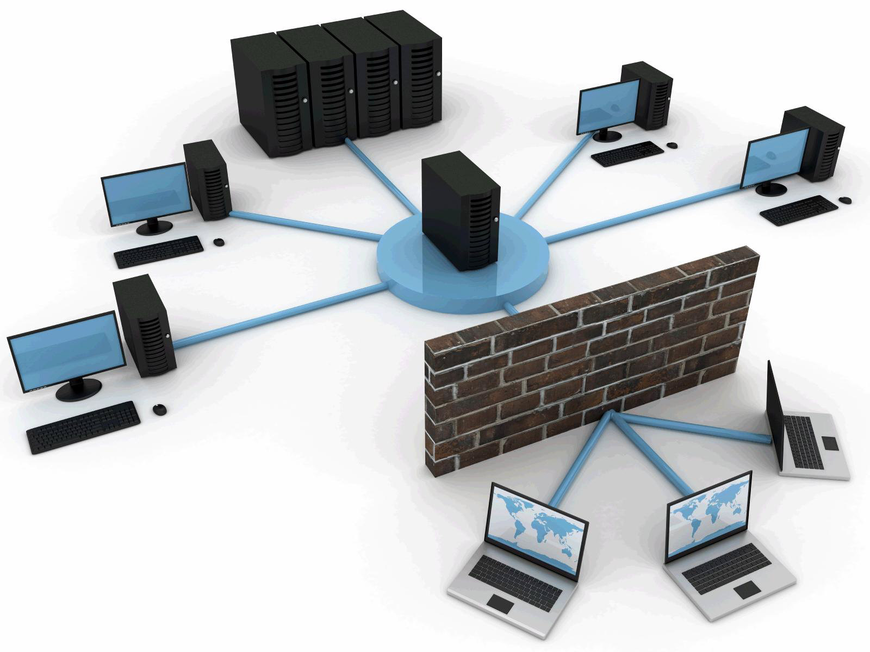

What is System Engineering?
Hardware
Database
Software
Network
People

Slide 33
What is System Engineering?
Systems engineering deals with work-processes and tools to handle such projects, and it overlaps with both technical and human-centered disciplines such as control engineering and project management.
System engineering deals with all aspects of computer-based system development.

Slide 34
What is System Engineering?
Software engineering is a part of system engineering.
System engineering is to identify the roles of hardware, software, people, database and other system elements involved with that system which is going to be developed.
Software engineering is to tell the practicalities of developing and delivering useful software.

Slide 35
Professional & Ethical Responsibility

Slide 36
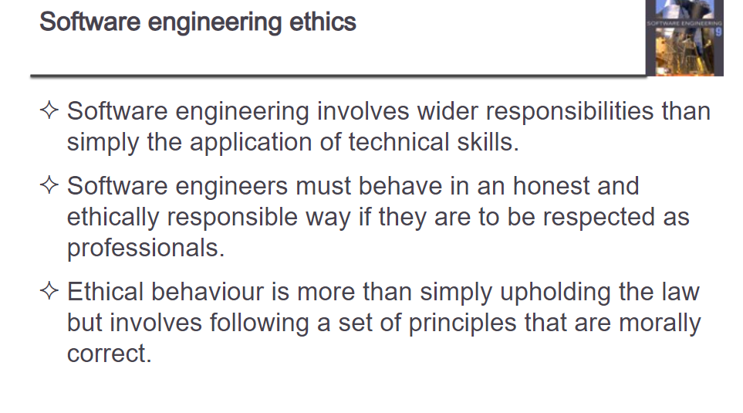

Slide 37
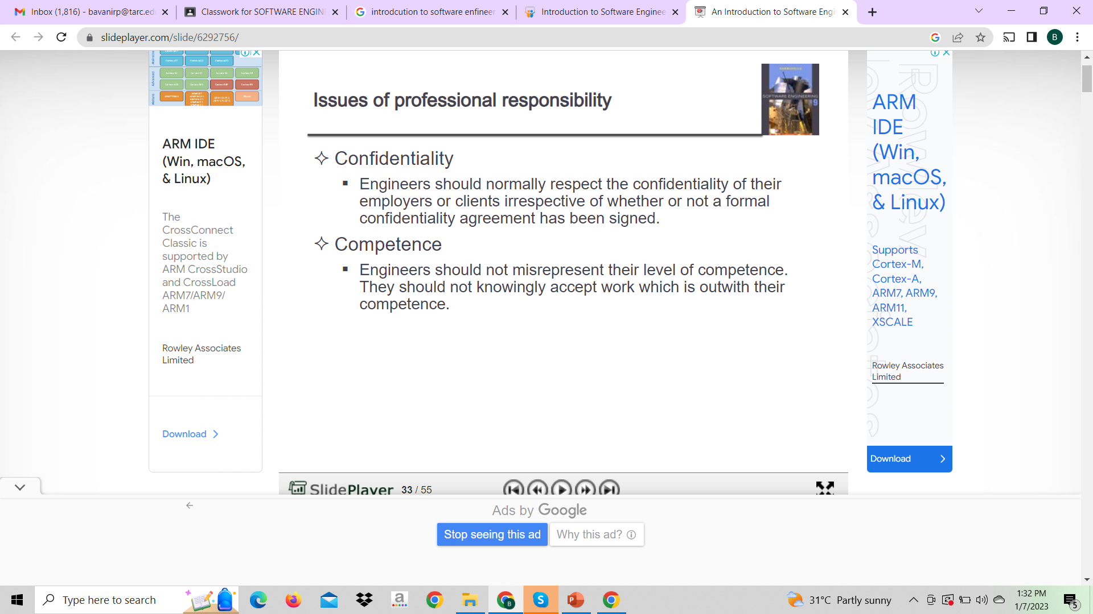

Slide 38
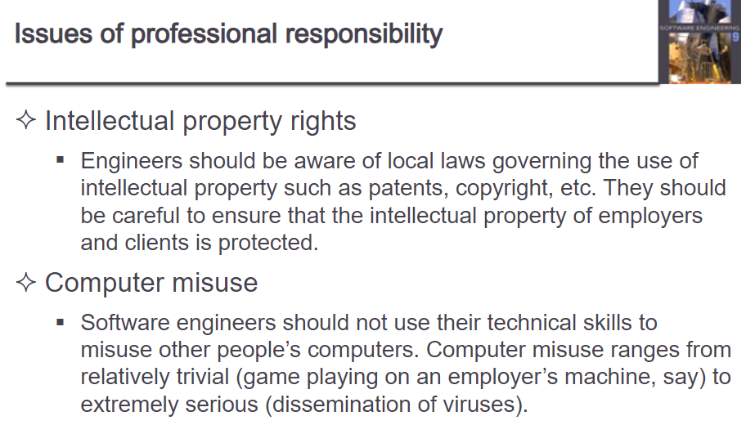

Slide 39
ACM/IEEE Code of Ethics
The professional societies in the US have cooperated to produce a code of ethical practice.
We have these posted along our inner hallways.
Members of these organizations sign up to the code of practice when they join.
Absolutely you need to belong to the ACM, IEEE CS and perhaps a couple of others in your area of specialization.
The Code contains eight Principles related to the behavior of and decisions made by professional software engineers, including practitioners, educators, managers, supervisors and policy makers, as well as trainees and students of the profession.
39

Slide 40

Professional & Ethical Responsibility
Professional responsibilities for software engineers include:
Confidentiality
Competence
Intellectual property rights
Computer misuse

Slide 41
ACM/IEEE Code of Ethics
The Software Engineering Code of Ethics focuses on providing high-quality software. They are committed to analyzing, specifying, designing, developing, testing, and maintaining software that is beneficial and effective for the company or client.

Slide 42
Professional & Ethical Responsibility
ACM/IEEE Code of Ethics
Public
Product
Manage-ment
Colleagues
Client & Employer
Judgment
Profession
Self
Notes:
Public interest e.g. Lynas project: Touted as the largest rare earth refinery, the LAMP will use 720 tons of concentrated Hydrochloride Acid (sulphuric acid) per day and leave behind 28,000 tonnes of solid waste per year, enough to fill 126 olympic size swimming pools. A by-product of this waste is radioactive Thorium (Th) which is dangerous to human health.

Slide 43
Professional & Ethical Responsibility
ACM/IEEE Code of Ethics
1. PUBLIC - Software engineers shall act consistently with the public interest.
CLIENT AND EMPLOYER - Software engineers shall act in a manner that is in the best interests of their client and employer consistent with the public interest.
3. PRODUCT - Software engineers shall ensure that their products and related modifications meet the highest professional standards possible.
4. JUDGMENT - Software engineers shall maintain integrity and independence in their professional judgment.

Slide 44
Professional & Ethical Responsibility
ACM/IEEE Code of Ethics
MANAGEMENT - Software engineering managers and leaders shall subscribe to and promote an ethical approach to the management of software development and maintenance.
PROFESSION - Software engineers shall advance the integrity and reputation of the profession consistent with the public interest.

Slide 45
Professional & Ethical Responsibility
ACM/IEEE Code of Ethics
7. COLLEAGUES - Software engineers shall be fair to and supportive of their colleagues.
8. SELF - Software engineers shall participate in lifelong learning regarding the practice of their profession and shall promote an ethical approach to the practice of the profession.

Slide 46
Revision
Generic vs. Bespoke software product
Software Engineering (SE) & its importance
Software Attributes
Key challenges of SE
ACM/IEEE code of ethics

